Slide 1


<MARCIO CARVALHO>
<08-12-2022>

Slide 2

Outline
Executive Summary
Introduction
Methodology
Results
Conclusion
Appendix

Slide 3
Executive Summary
Summary of methodologies:
Data Collection
Data Wrangling
Exploratory Data Analysis (EDA) using SQL
Exploratory Data Analysis (EDA) using Pandas e Matplotlib
Interactive Visual Analytics e Dashboard
Predictive Analysis (Classification)
Summary of all results:
Exploratory data analysis results
Interactive analytics demo in screenshots
Predictive analysis results

Slide 4
Introduction
The commercial space age is here, companies private are making space travel affordable for everyone.
SpaceX advertises Falcon 9 rocket launches on its website with a cost of 62 million dollars;
other providers cost upwards of 165 million dollars each, much of the savings is because
SpaceX can reuse the first stage.
So if we can predict whether the first stage will land, we can determine the cost of a launch.
The objective of the project is to analyze and predict the ideal conditions for reuse first stage of launch.
Answering the following questions:
Falcon9 rocket will land successfully and be able to generate references for future competitors?
What are the location with the best launch results?
What size of the first stage was most successful?
How accurate are the success predictions of the best launch sites?

Slide 5

Section 1

Slide 6
Methodology
Executive Summary:
Data collection methodology
With Request to the SpaceX API e Web Scrapping
Perform data wrangling
In this step we will mainly convert those outcomes into Training Labels with 1 means the booster successfully landed and 0 means it was unsuccessful and cleaning data from null values ​​and irrelevant columns.
Perform exploratory data analysis (EDA) using visualization and SQL
Perform interactive visual analytics using Folium and Plotly Dash
Perform predictive analysis using classification models
Logistic Regression (LR), Support Vector Machine (SVC), Decision Tree Classifier (Tree), K - Neighbors Classifier (KNN) models and evaluated for the best classifier.

Slide 7
Data Collection
Datasets were collected using SpaceX API at the web address: https://api.spacexdata.com/v4/
Datasets were collected using wiki page at the web address: https://en.wikipedia.org/wiki/List_of_Falcon_9_and_Falcon_Heavy_launches
IMPORT
LIBRARIES
REQUEST GET API /
JSON
LOADS /
NORMALIZE JSON
CONSTRUCT OUR DATASET USING THE DATA JSON
WE HAVE
OBTAINED
FILTER THE
DATAFRAME
TO ONLY INCLUDE FALCON 9
LAUNCHES
DATA READY FOR WRANGLING
EXTRACT ALL COLUMN /
VARIABLE
NAMES FROM THE HTML TABLE HEADER
CREATING A DATAFRAME BY PARSING
THE LAUNCH HTML TABLES
REQUEST FALCON 9 LAUNCH WIKI PAGE FROM ITS URL
IMPORT
LIBRARIES

Slide 8
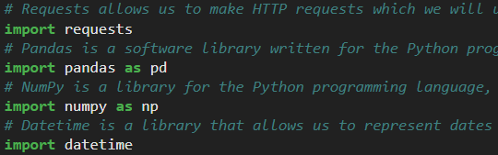
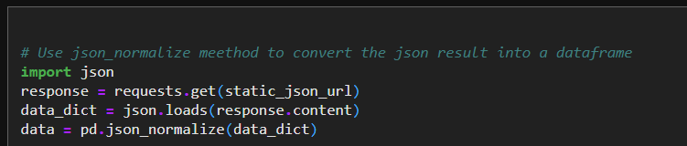
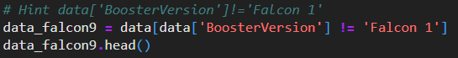
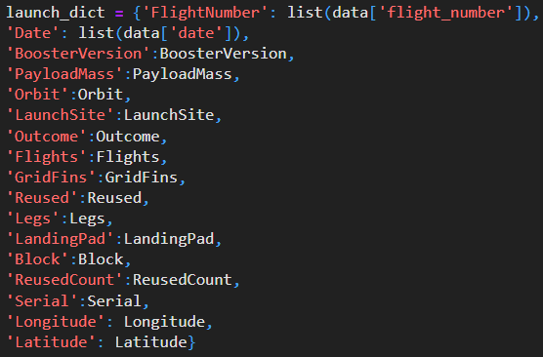
Data Collection – SpaceX API
1. IMPORT LIBRARIES:
2. REQUEST GET API / JSON LOADS/ NORMALIZE JSON:
4. FILTER DATAFRAME ONLY INCLUDE FALCON 9 LAUNCH:
3. CONSTRUCTING DATASET USING JSON :
5. DATA READY FOR WRANGLING:
Github URL:
https://github.com/MarcioCarvalho2022/Python-Basics-for-data-Science-Project/blob/main/jupyter-labs-spacex-data-collection-api%20(1).ipynb

Slide 9
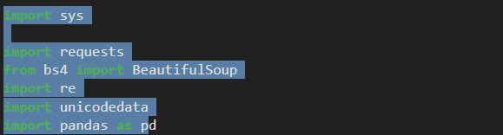
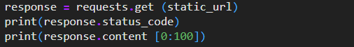
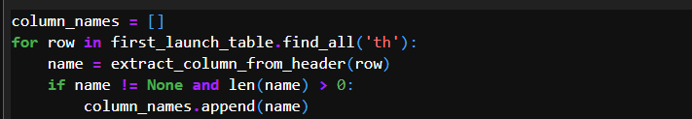
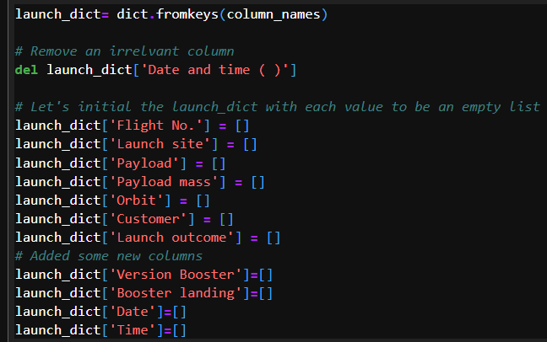
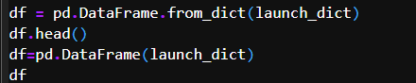
Data Collection - Scraping
1. IMPORT LIBRARIES:
2. REQUEST FALCON 9 LAUNCH WEB SCRAPING:
3. EXTRACT ALL COLUMN:
4. CONSTRUCTING DATASET USING WEB THE DATA:
5. Building dataframe:
Github URL:
https://github.com/MarcioCarvalho2022/Python-Basics-for-data-Science-Project/blob/main/jupyter-labs-webscraping%20.ipynb

Slide 10
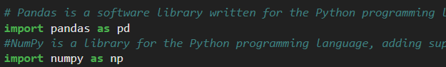
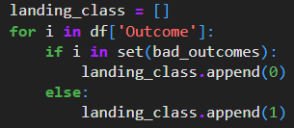
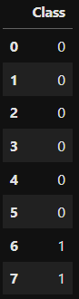
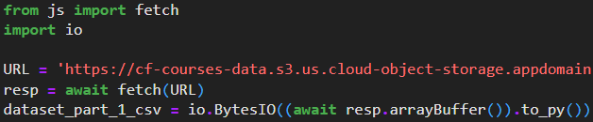
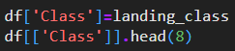
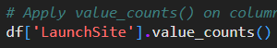
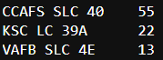
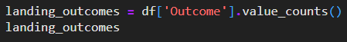
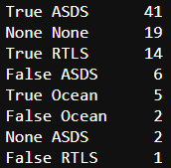
Data Wrangling
1. IMPORT LIBRARIES AND LOADING DATASET:
4. FINDING THE BAD OUTCOMES TO FIND SUCCESS RATE
2. NUMBER OF LAUCHES ON EACH SITE:
3. LANDING OUTCOMES IN SPECIFIC REGION:
Github URL:
https://github.com/MarcioCarvalho2022/Python-Basics-for-data-Science-Project/blob/main/labs-jupyter-spacex-data_wrangling_jupyterlite.jupyterlite.ipynb
5. SUCESS RATE

Slide 11
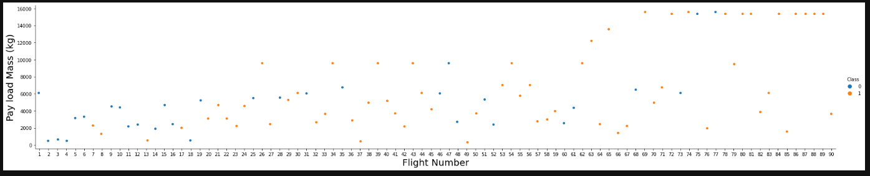
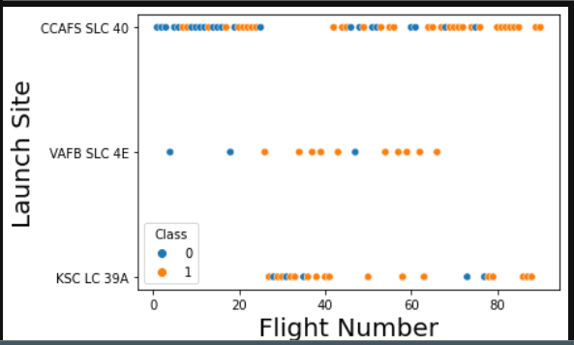
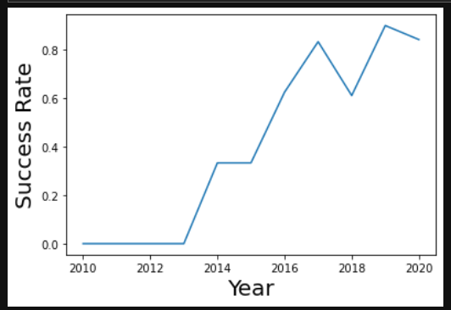
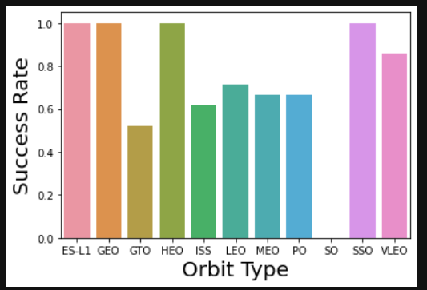
EDA with Data Visualization
1. Plot the FlightNumber vs. PayloadMass(kg) and about the launch result
2. Relationship between Flight Number and Launch Site about the launch result
Github URL:
https://github.com/MarcioCarvalho2022/Python-Basics-for-data-Science-Project/blob/main/IBM-DS0321EN-SkillsNetwork_labs_module_2_jupyter-labs-eda-dataviz.ipynb
3. Success rate of each orbit type
4. Launch success yearly trend

Slide 12
EDA with SQL
SQL queries to solve the assignment tasks:
Display the names of the unique launch sites in the space mission
Display 5 records where launch sites begin with the string 'CCA'
Display the total payload mass carried by boosters launched by NASA (CRS)
Display average payload mass carried by booster version F9 v1.1
List the date when the first succesful landing outcome in ground pad was achieved
List the names of the boosters which have success in drone ship and have payload mass greater than 4000 but less than 6000
List the total number of successful and failure mission outcomes
List the names of the booster_versions which have carried the maximum payload mass. Use a subquery
List the records which will display the month names, failure landing_outcomes in drone ship ,booster versions, launch_site for Rank the count of successful landing_outcomes between the date 04-06-2010 and 20-03-2017 in descending order.
Rank the count of successful landing_outcomes between the date 04-06-2010 and 20-03-2017 in descending order.
Github URL: https://github.com/MarcioCarvalho2022/Python-Basics-for-data-Science-Project/blob/main/jupyter-labs-eda-sql-coursera_sqllite%20(2).ipynb

Slide 13
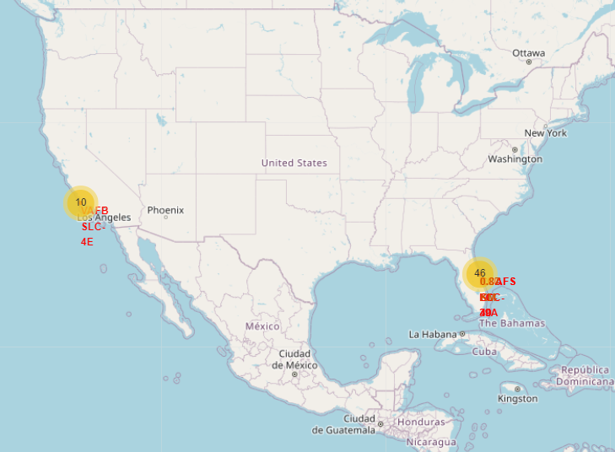
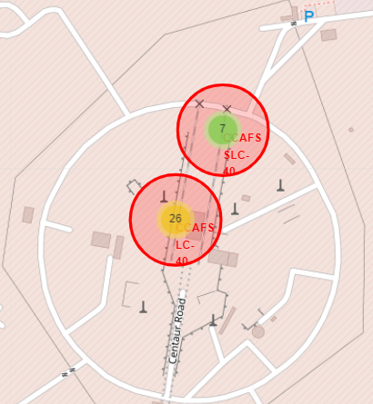
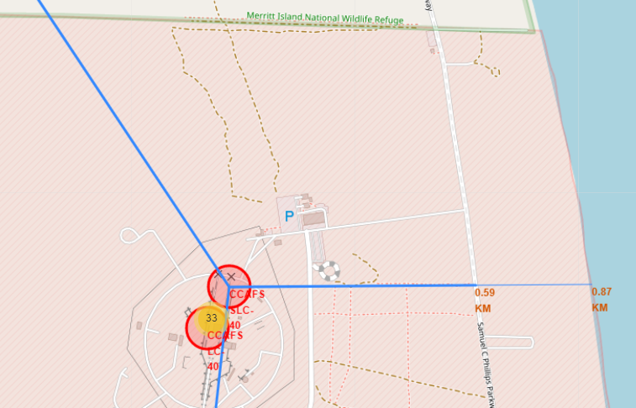
Build an Interactive Map with Folium
Some of the Folium methods used:
1- site_map = folium.Map - ADD map with informed coordinates
2- marker = folium.map.Marker - ADD markup or description
3- circle = folium.Circle - ADD circle at predefined coordinate
4- mouse_position = MousePosition - Add mouse position to get coordinate
5- lines=folium.PolyLine - ADD line on map
6- marker_cluster = MarkerCluster() - ADD grouping of markers
7- Site_map.add_child - ADD the previous items on the map
GITHUB: https://github.com/MarcioCarvalho2022/Python-Basics-for-data-Science-Project/blob/main/IBM-DS0321EN-SkillsNetwork_labs_module_3_lab_jupyter_launch_site_location.jupyterlite%20(1).ipynb

Slide 14
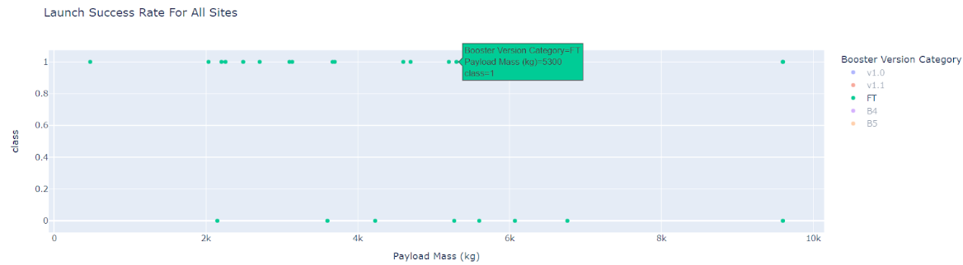
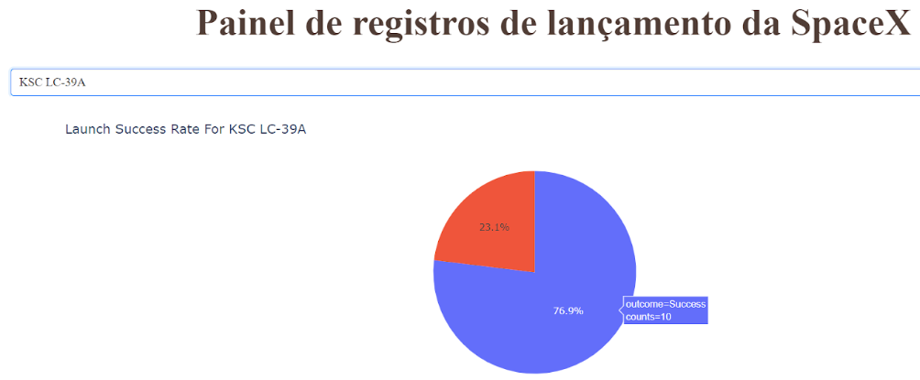
Build a Dashboard with Plotly Dash
A Dashboard was developed to facilitate the visualization of the responses below, among others:
Which site has the biggest hit launches?
Which site has the highest launch success rate?
Which payload range(s) has the highest launch success rate?
Which payload range(s) has the lowest launch success rate?
Which version of F9 Booster (v1.0, v1.1, FT, B4, B5, etc.) launch success rate?
GITHUB: https://github.com/MarcioCarvalho2022/Python-Basics-for-data-Science-Project/blob/main/dash_final.py

Slide 15
Predictive Analysis (Classification) - To be continued
CREATE A COLUMNS FOR THE CLASS
STANDARLIZE THE DATA
SPLIT INTO
TRAINING
DATA AND
TEST DATA
FIND THE METHOD PERFORMS
BEST USING TEST DATA
AUTOMATINGTHE PROCESS
WITH THE
GRIDSEACHCV TOOL
CALCULATE
THE ACCURACY ON THE TEST DATA USING THE METHOD CONFUSION MATRIX
CALCULATE THE ACCURACY ON THE TEST DATA USING THE METHOD SCORE
TESTING
WITH THE BEST
PARAMETERS LR / KNN / TREE / SVM
BEST PREDICTION MODEL
FINDING THE METHOD PERFORMS BEST

Slide 16
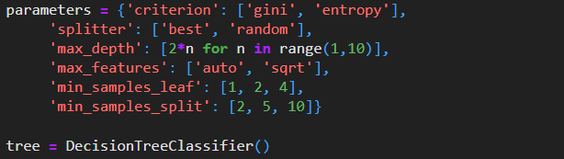
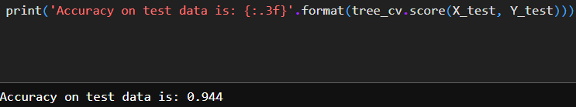
Predictive Analysis (Classification)
A great advantage of using the GRIDSEARCHCV tool, in addition to training the decision trees in different parameters, is that the result is already validated with Cross Validation, and in our case it was in 10 different parts of the dataset reserved for training.
GitHub URL:https://github.com/MarcioCarvalho2022/Final-Project-Data-Science-Coursera/blob/main/IBM-DS0321EN-SkillsNetwork_labs_module_4_SpaceX_Machine_Learning_Prediction_Part_5.jupyterlite.ipynb

Slide 17
Results
Exploratory data analysis results
Interactive analytics demo in screenshots
Predictive analysis results

Slide 18

Section 2

Slide 19
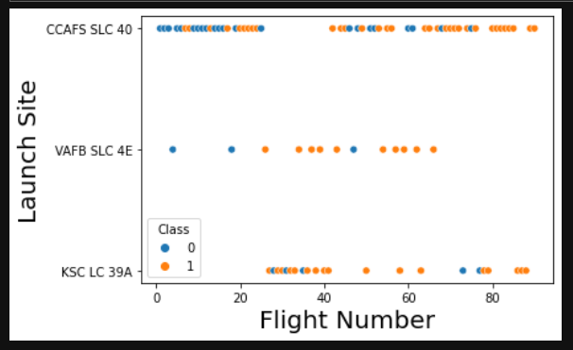
Flight Number vs. Launch Site
Success rate PFB SLC 4E and KSC LC 39A is higher CCAFS SLC 40 even with lower launch amounts.
As more experience launches on each site, the success rate increases.

Slide 20
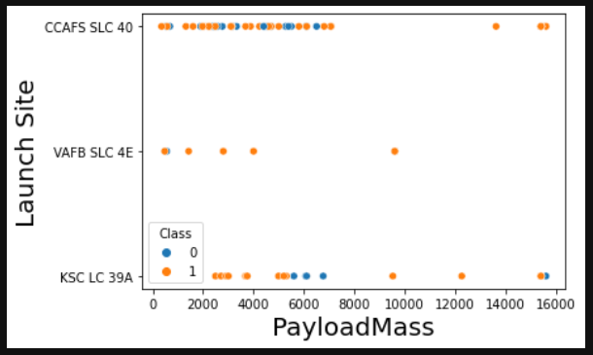
Payload vs. Launch Site
The payload with the highest launch success rate is between 2000-4000kg
The payload with the lowest launch success rate is between 4000-8000kg
The payload between 8000 and 15000kg has not failed to launch any site.

Slide 21
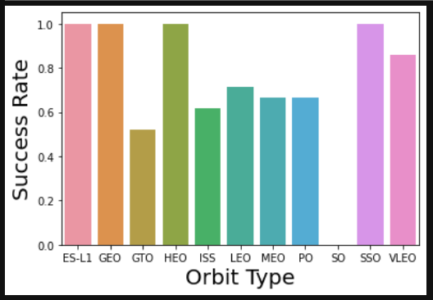
Success Rate vs. Orbit Type
The ES-L1, GEO, HEO, SSO orbits have 100% success rates.

Slide 22
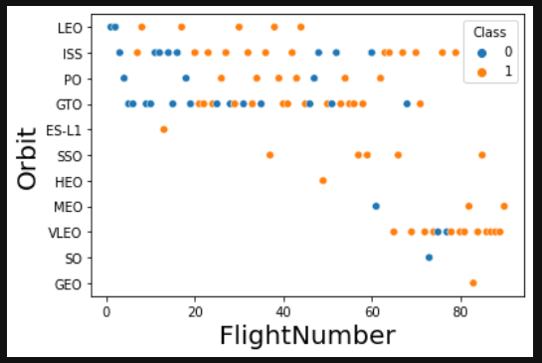
Flight Number vs. Orbit Type
Due to the greater proximity to the earth operating at the observation points, the VLEO orbit has been more used in recent launches.
LEO's orbit has increased the rate of launches with more experience.
The GTO orbit has a very large variance of success and failure and should be avoided until you find out the real reason.

Slide 23
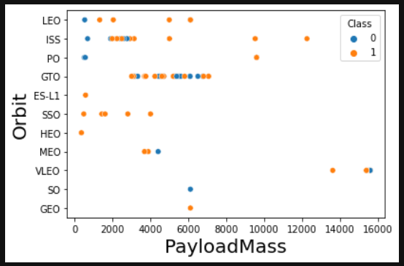
Payload vs. Orbit Type
For the LEO, ISS and PO orbits after a payload of 4000kg the success rate was 100%.
SSO orbit had 100% success rate with payloads up to 4000kg.
GTO orbit has unstable success rate regardless of payload.

Slide 24
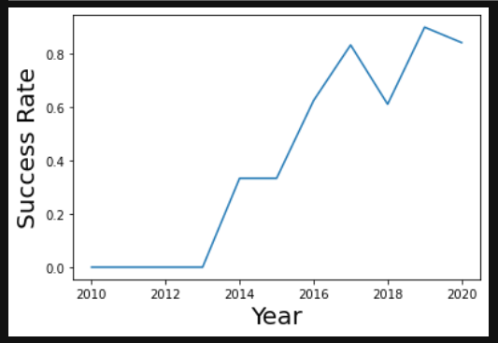
Launch Success Yearly Trend
The success rate from 2013 had a great growth until 2017, with the growth being interrupted in 2018 and the rate increasing again in 2019. It is possible that the experience had a great impact on success.

Slide 25
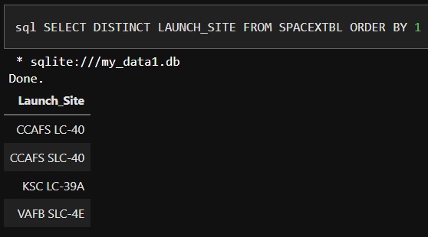
All Launch Site Names
DISTINCT filter was used to show unique values

Slide 26
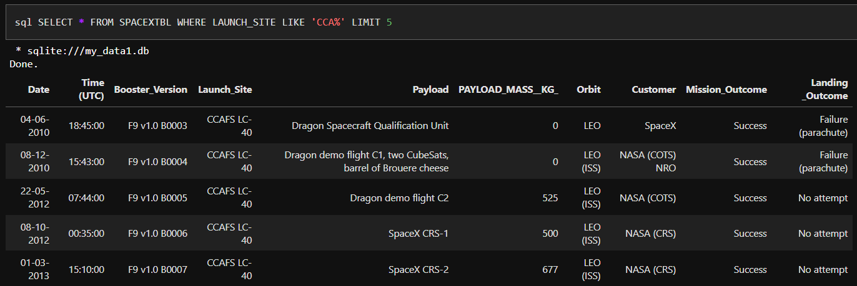
Launch Site Names Begin with 'CCA'
To show the 5 lines LIMIT was used

Slide 27
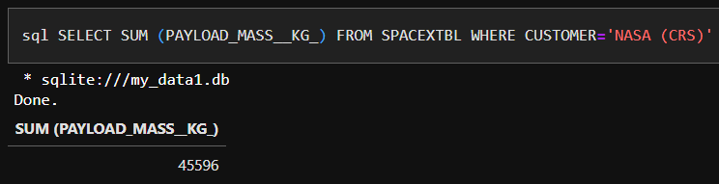
Total Payload Mass
To find the result we use SUM

Slide 28
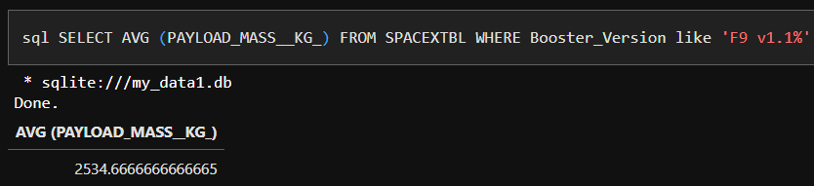
Average Payload Mass by F9 v1.1
To find the result we use AVG

Slide 29
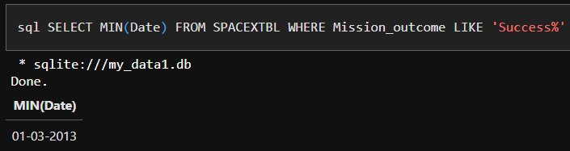
First Successful Ground Landing Date
To find the result we use MIN

Slide 30
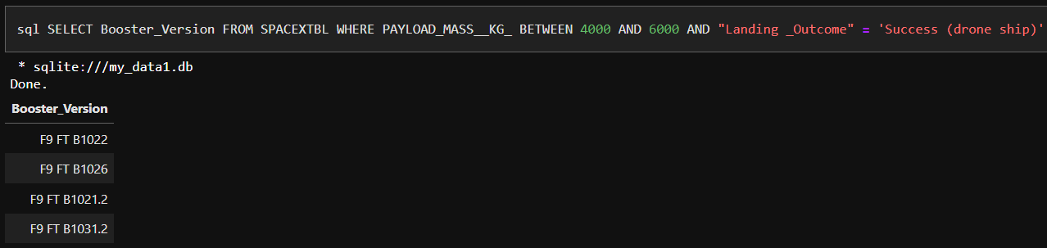
Successful Drone Ship Landing with Payload between 4000 and 6000
To find the result we use BETWEEN

Slide 31
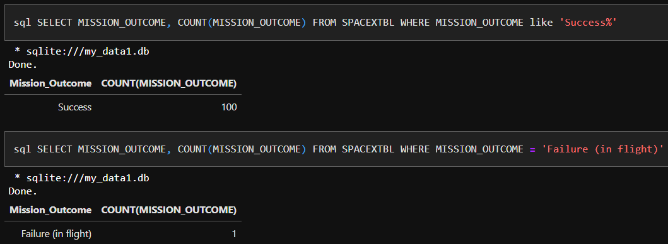
Total Number of Successful and Failure Mission Outcomes
To find the result we use COUNT

Slide 32
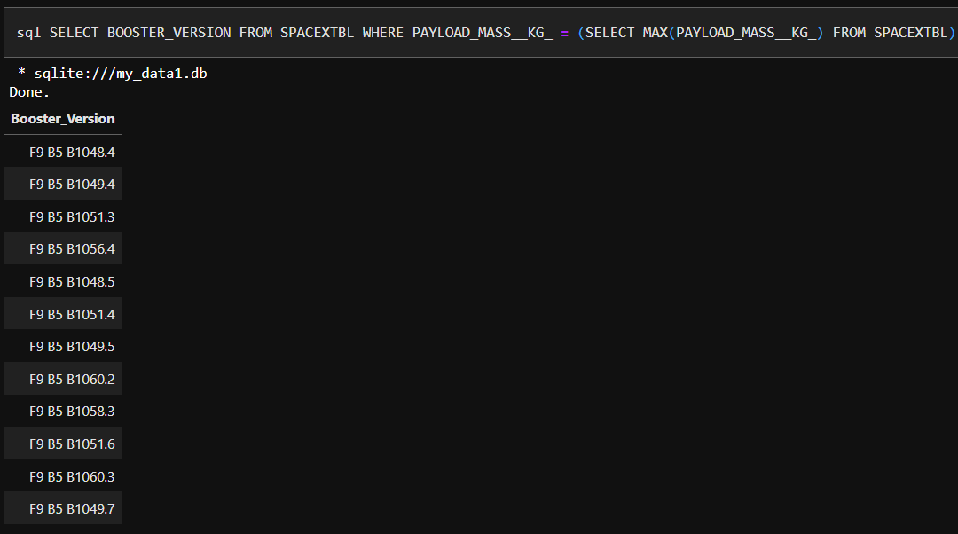
Boosters Carried Maximum Payload
To find the result we use MAX and Subquery

Slide 33
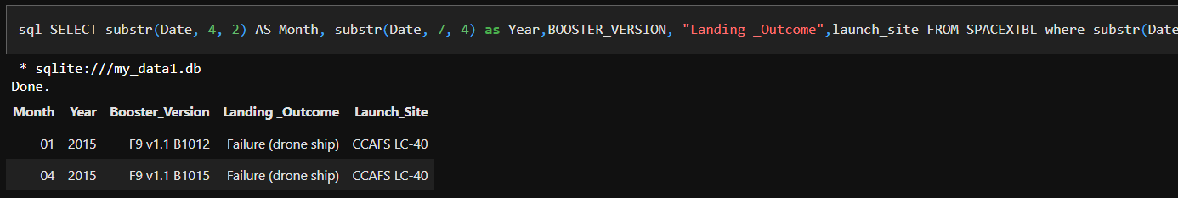
2015 Launch Records
To find the result we use SUBST(DATE,Y,M)

Slide 34
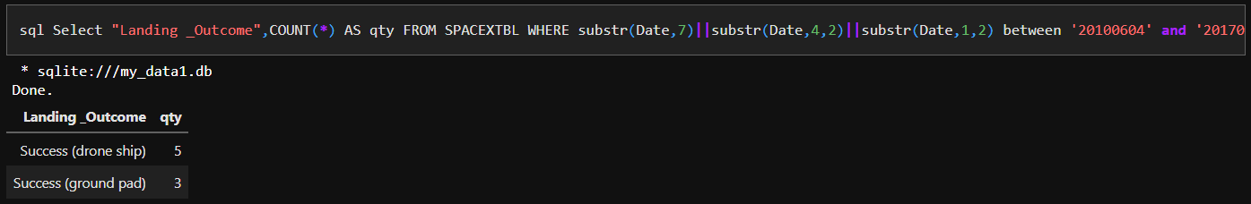
Rank Landing Outcomes Between 2010-06-04 and 2017-03-20
To find the result we use SUBST(DATE,Y,M) AND BETWEEN

Slide 35

Section 3

Slide 36
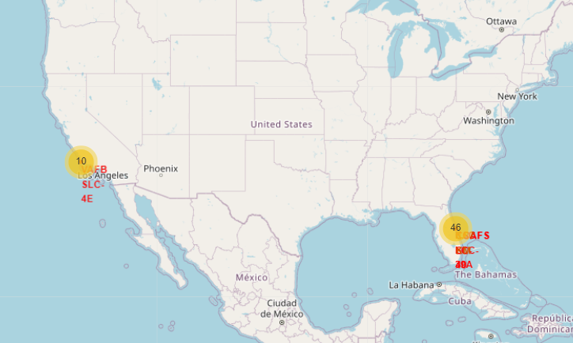
ALL LAUNCH SITES
ALL LAUNCH LOCATIONS ARE NEAR THE SEA

Slide 37
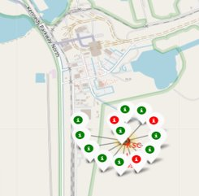
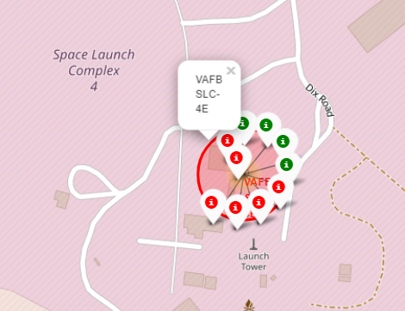
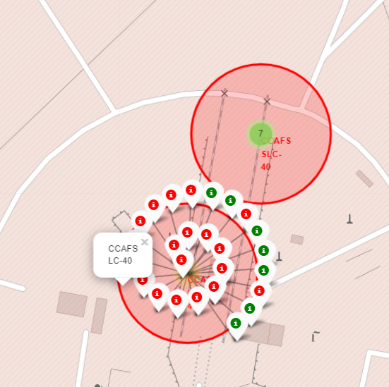
Launch results marked by colors on the map
KSC LC 39A HAD THE BEST SUCCESS RATE
Landing Outcome:
Green = success Red = failure

Slide 38
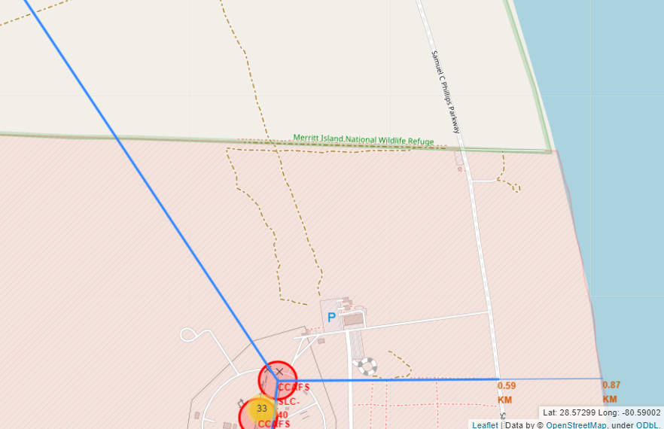

Launch site and surroundings
Launch sites have reasonable distances to railroads, highways, the coast and large urban centers

Slide 39

Section 4

Slide 40

Launch success count for all sites
KSC LC 39A has the highest hit score with 41,2%
CCAFS LC-40 has the lowest success score with 14,4%

Slide 41

Launch site with highest success rate
KSC LC 39A had a 76,9% success rate.
KSC LC 39A had a 23,1% failure rate.

Slide 42


Payload vs. Launch Outcome for all sites
Booster version V1.0 and V1.1 with load up to 4000kg has the lowest success rate.
Payloads between 4000 and 8000 kg had the lowest success rate for all sites.
Booster version FT in the payload range between 2000-4000kg has the highest success rate.

Slide 43

Section 5

Slide 44

Classification Accuracy
Decision Tree model has the highest classification accuracy (90%)

Slide 45

Confusion Matrix
Decision tree model confusion matrix
Predicted success results (TP) had an assertiveness of 80% and False positive (FP) 20%.
With advancing technology and new calculation algorithms, the results for true negatives and false positives tend to become more accurate.

Slide 46
Conclusions
Launch site with the most successful result was the KSC LC 39A with a payload of up to 5500kg for larger loads do not use Booster version FT, for the other Boosters there is not enough data.
Booster version V1.0 and V1.1 with load up to 4000kg has the lowest success rate.
Payloads between 4000 and 8000 kg had the lowest success rate for all sites.
Booster version FT in the payload range between 2000-4000kg has the highest success rate.
The success rate from 2013 had a great growth until 2017, with the growth being interrupted in 2018 and the rate increasing again in 2019. It is possible that the experience had a great impact on success.
For the LEO, ISS and PO orbits after a payload of 4000kg the success rate was 100%.
SSO orbit had 100% success rate with payloads up to 4000kg.
GTO orbit has unstable success rate regardless of payload.
Due to the greater proximity to the earth operating at the observation points, the VLEO orbit has been more used in recent launches.
LEO's orbit has increased the rate of launches with more experience.
The GTO orbit has a very large variance of success and failure and should be avoided until you find out the real reason.

Slide 47
Appendix
For more information, follow the link below to view the complete project material.
https://github.com/MarcioCarvalho2022/Final-Project-Data-Science-Coursera

Slide 48
Acknowledgment
"I thank God first. There are all the professors, classmates and family for their support and help given to this eternal learner."
- Marcio Carvalho
https://www.coursera.org/
https://cloud.ibm.com/
https://github.com/
https://www.infnet.edu.br/infnet/home/
https://www.google.com.br/

Slide 49


